Slide 1

Capstone 2 Final Project Report: Predicting Tech Startups in Los Angeles
Wesley Hall September 7, 2024

Slide 2

OBJECTIVE
Predict the future spatial distribution of technology startups in Los Angeles to inform urban, education & economic policies.
Analysis is based on business, registration data, educational attainment metrics, and temporal factors.
Analysis confined to Santa Monica, Venice, Westside L.A., Downtown by Zip Codes (to increase performance efficiency)
Tech companies rely on an educated workforce to thrive. Knowing the types of technology startups that will develop in the coming years will inform the allocation of energy and resources in coming years.

Slide 3

Data Sources
Business Registrations Dataset includes business registration information categorized by NAICS codes, zip codes, geographic coordinates (latitude, longitude), and registration dates. Site: https://data.lacity.org/Administration-Finance/Listing-of-Active-Businesses/6rrh-rzua/data
Educational Attainment Metrics on educational attainment (e.g., percentage of the
population with bachelor's degrees or high school diplomas) by zip code.
Site: https://data.census.gov/table?q=educational%20attainment%20by%20zip%20code&g=010XX00US_050XX00US06037

Slide 4
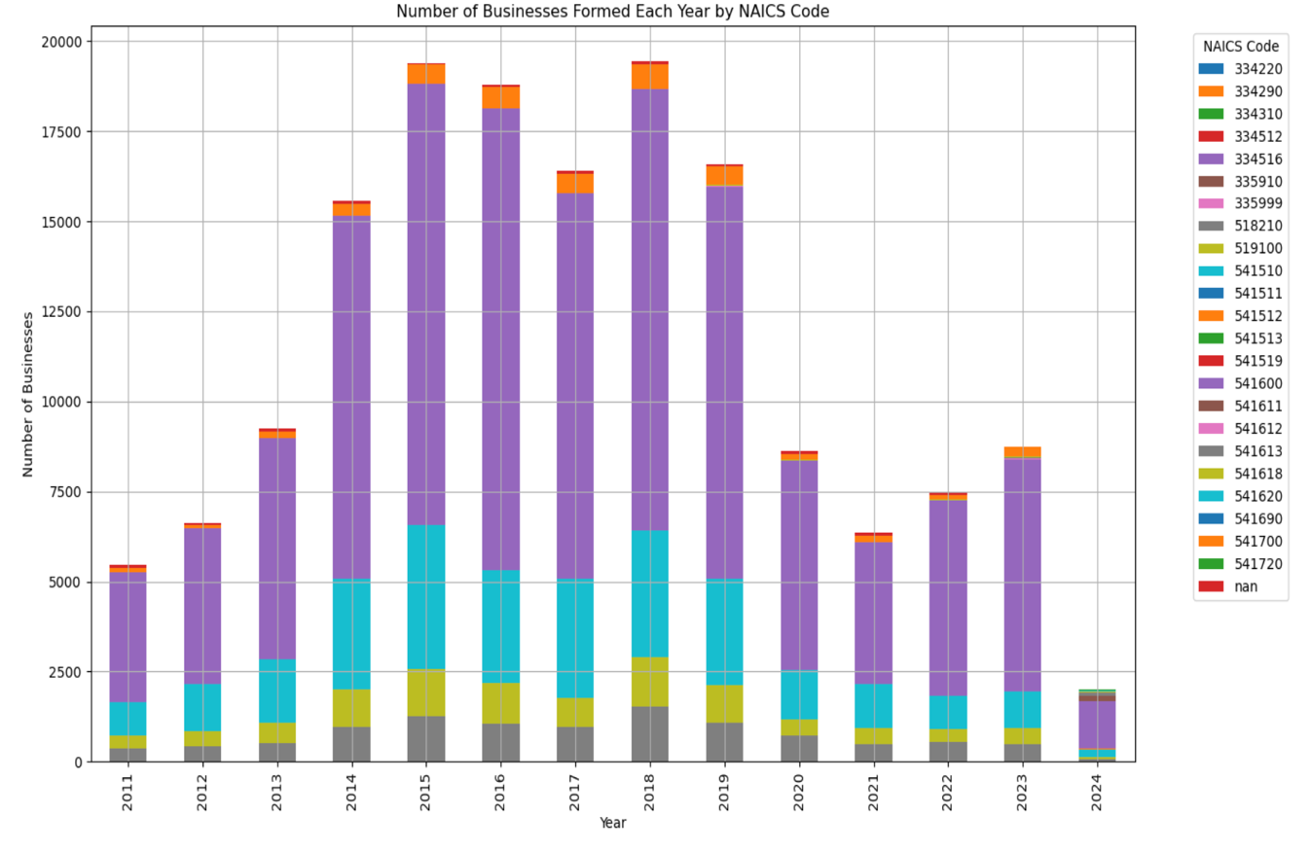
TECH BUSINESSES 2011-2024
Classified by NAICS Code in Govt. Census.
General Consulting Services (541600) and Environmental Consulting Services (541620) are majority classifications.
Filtered non-performing NAICS through EDA & Preprocessing
Major drop starting in 2020 (COVID era). Years 2023, 2024 elimina
Data includes geospatial coordinates for clustering predictions.

Slide 5
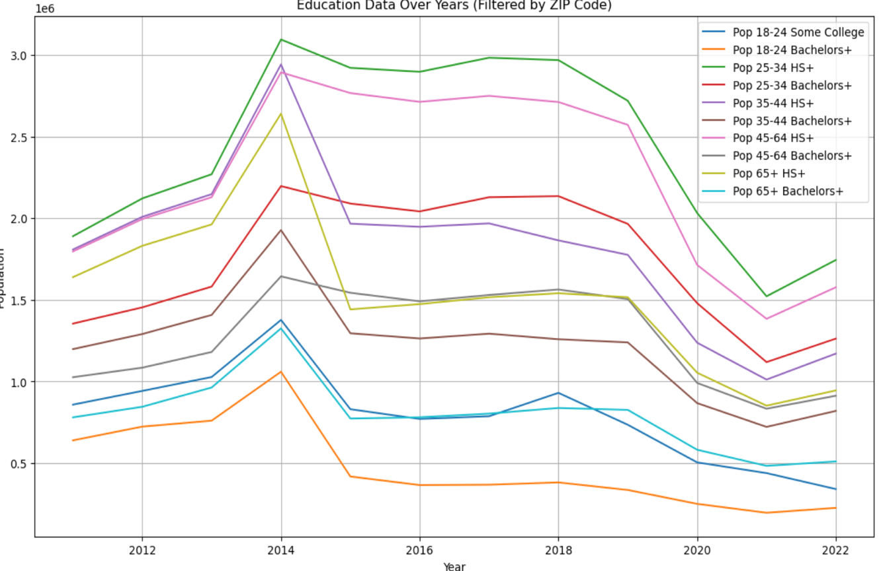
EDUCATION LEVELS 2011 - 2022
Education Levels provided by age groups.
Highest predictive category - Pop 65+ Bachelors
Notable drop in education attainment during 2019-2020 (COVID era), then increase
Anomaly made predictions more difficult, challenging cross validation.
EDA & Preprocessing indicated those only attending high school weren’t predictive.
No data for 2023, 2024

Slide 6
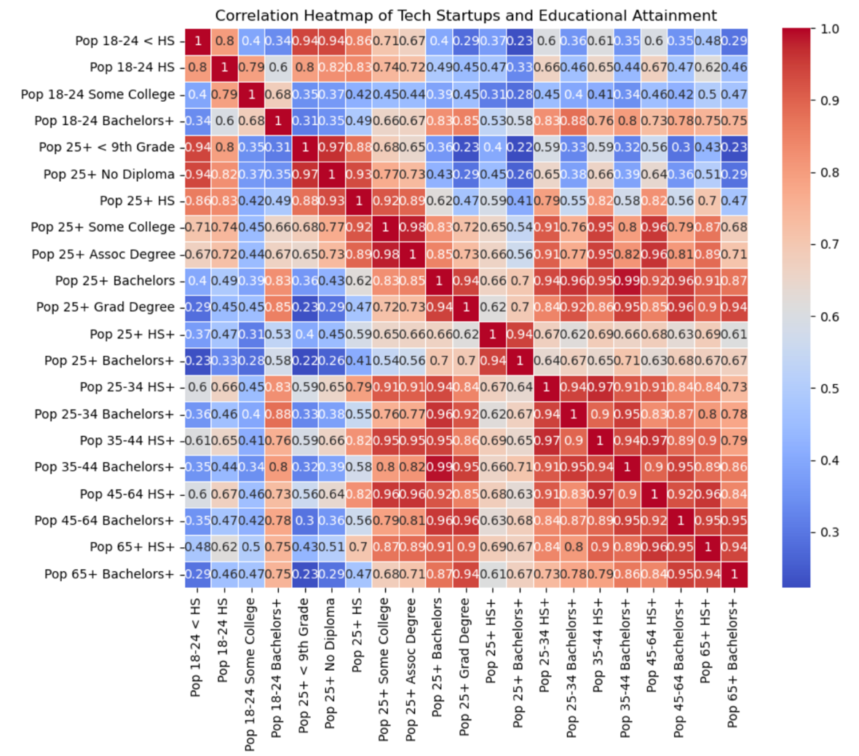
Correlation Heatmap
Shows strong positive correlation between areas with a higher percentage of bachelor's degrees and tech startups.

Slide 7
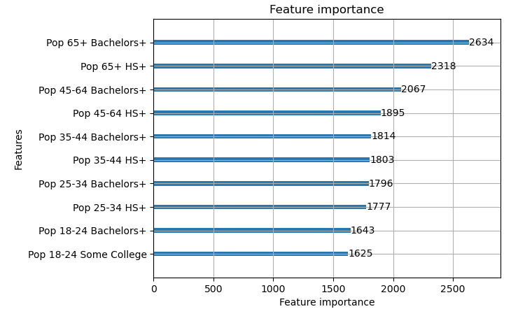
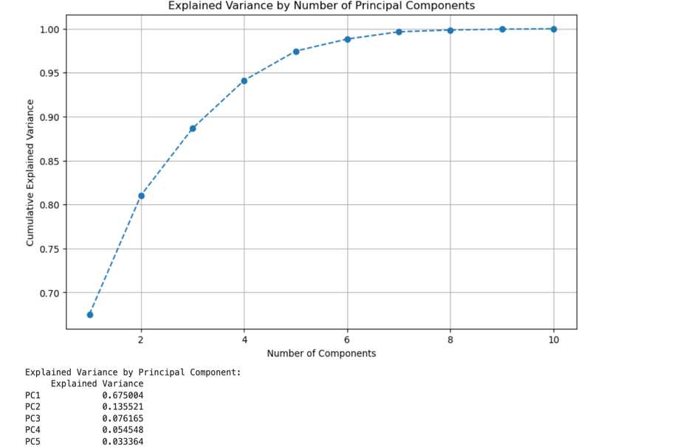
PCA
TOP FEATURES
PCA initiation reduced redundancy and dimensionality in our dataset & minimized overfitting.
PC1 explains 75.66% of data variance. Adding PC2-PC5 gets us to 97.43% of explained variance.
PCA helped identify the most influential labels in our dataset in predicting tech company distributions.
Education attainment by the 65+ population has the most influence, followed by the 45+64 population. Experience, connections and deeper pockets are could be factors.

Slide 8

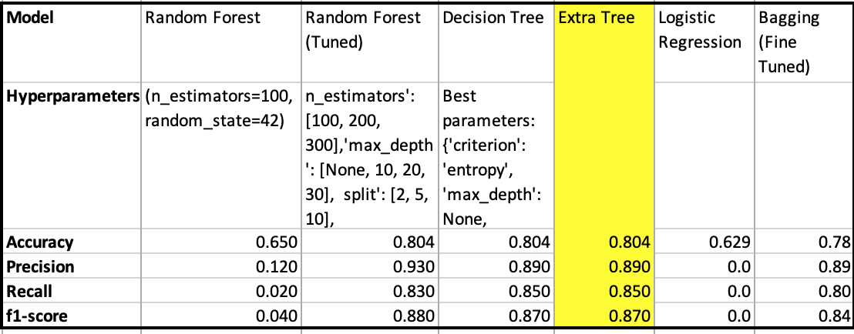
Model Performance

Slide 9
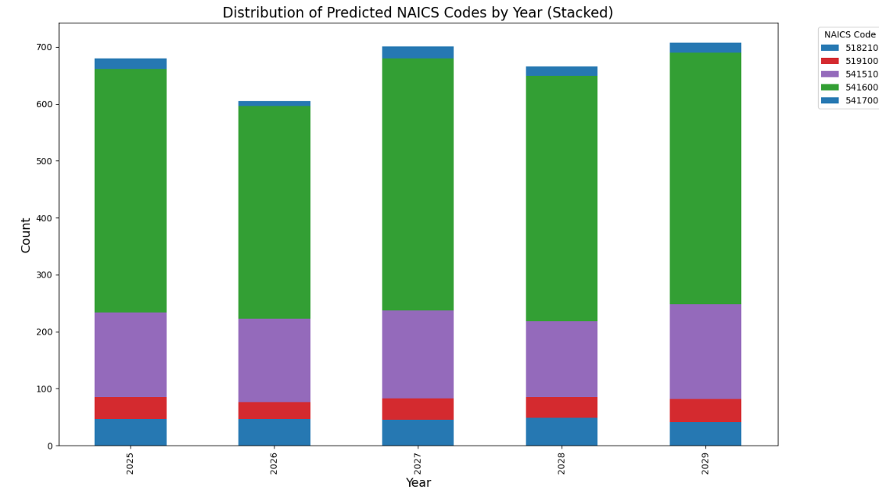
Predicted NAICS Distribution 2025-2029
Growth is moderate and stable.
Decline and gain of 100 avg. businesses annually.

Slide 10
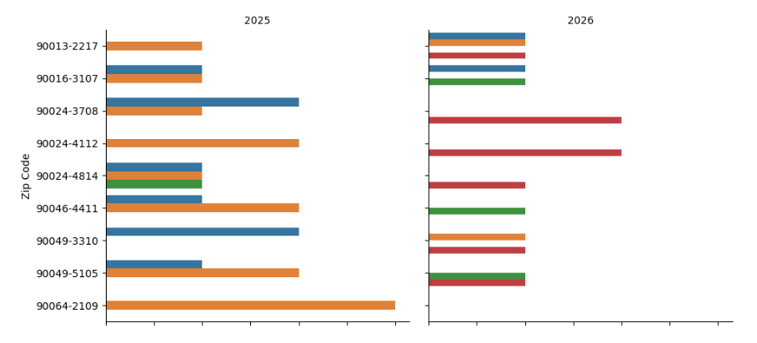
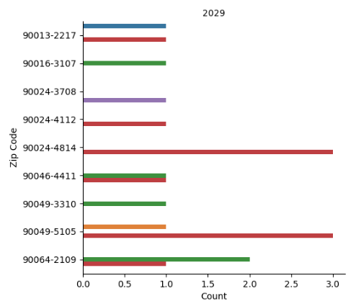
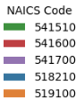
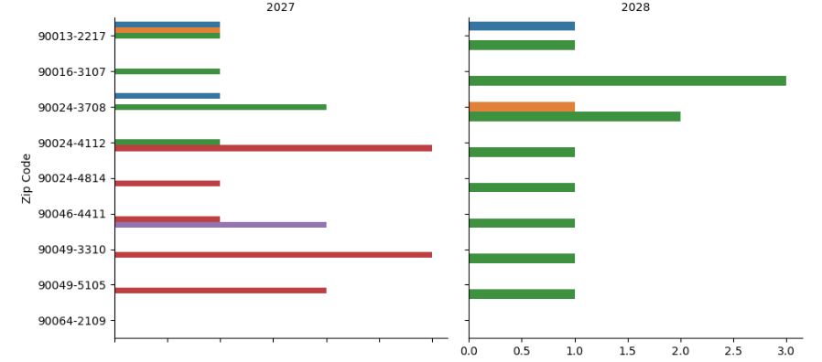
Distribution of NAICS by Zip Code

Slide 11
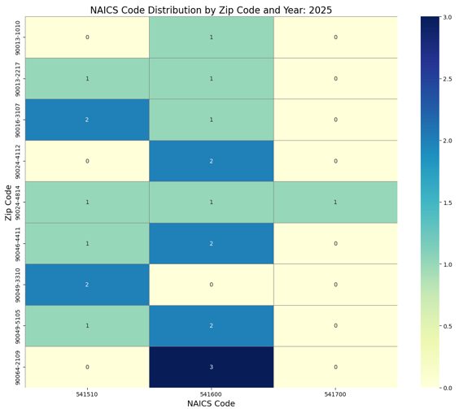
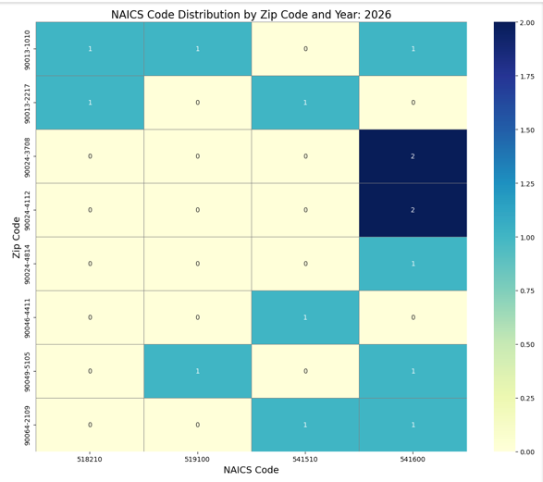
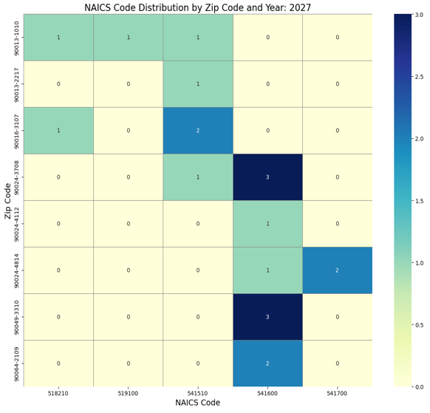
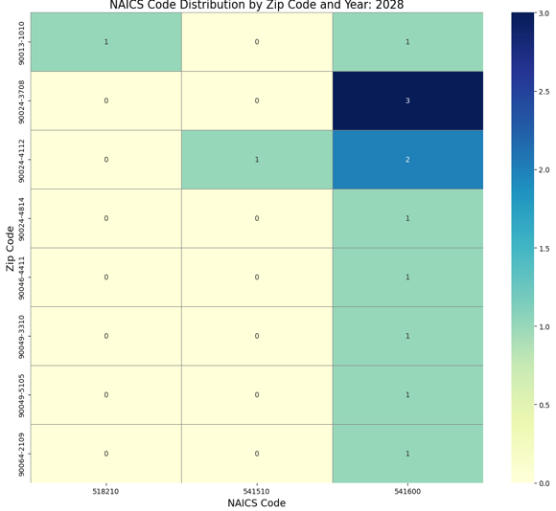
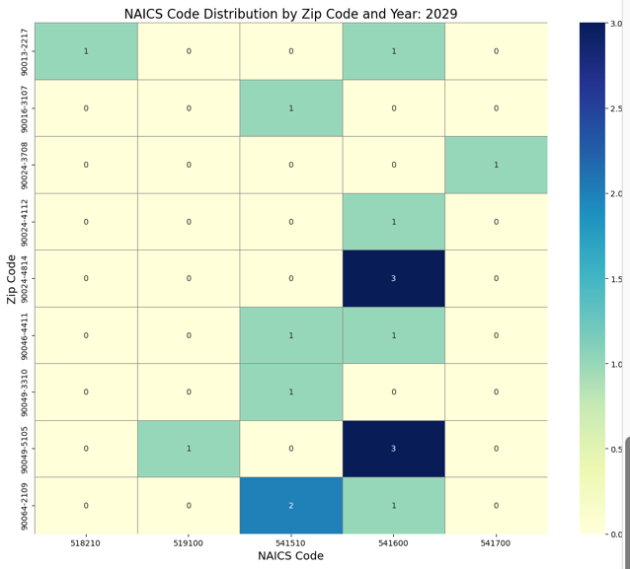
YEARLY HEATMAPS SHOW NAICS CONCENTRATION BY ZIP CODE

Slide 12
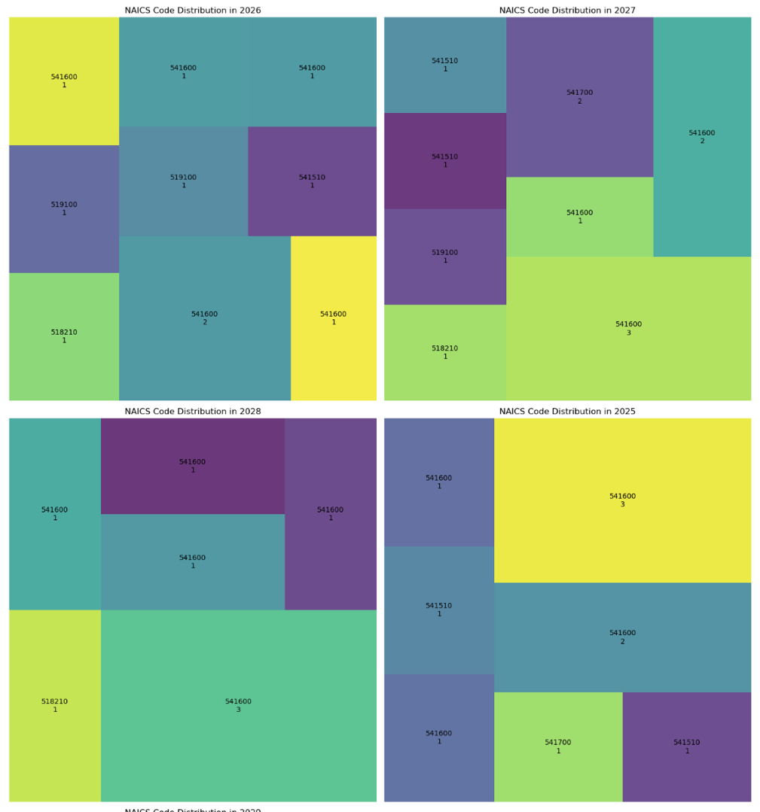
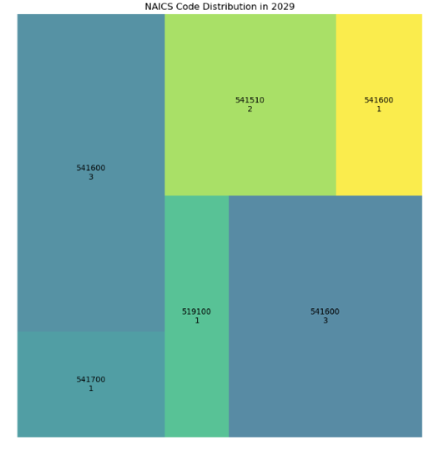
TreeMaps shows concentration of tech business formation by year

Slide 13
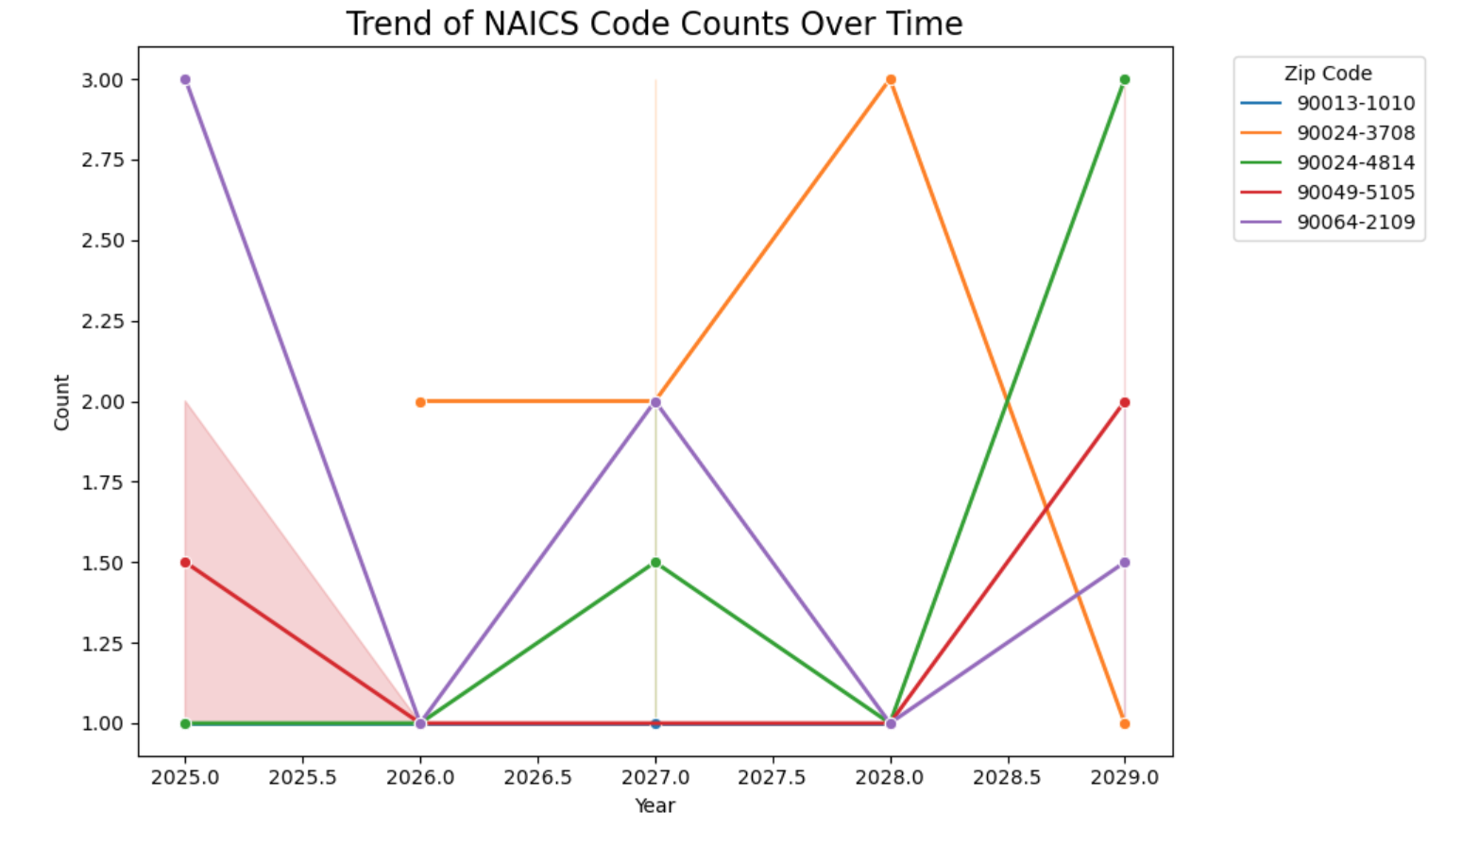

Slide 14
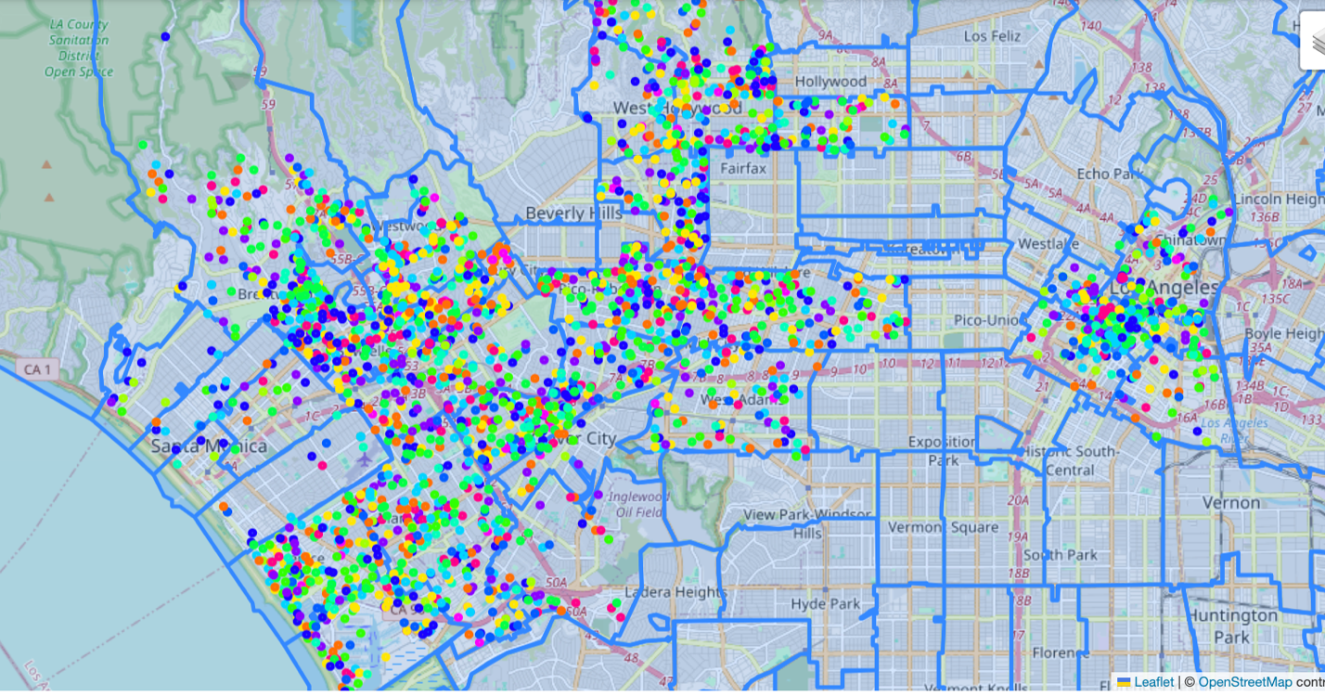
Tech Cluster Predictions

Slide 15
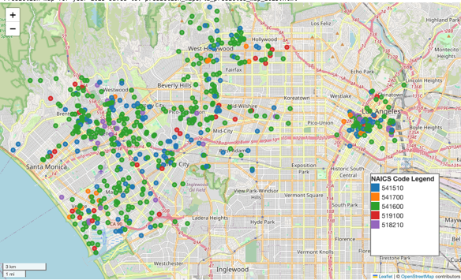
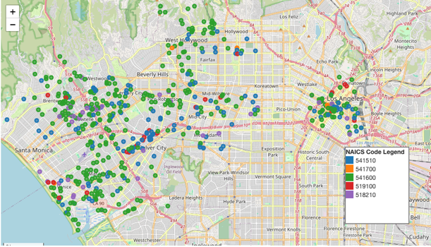
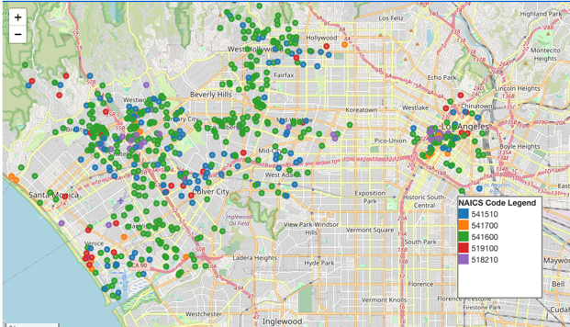
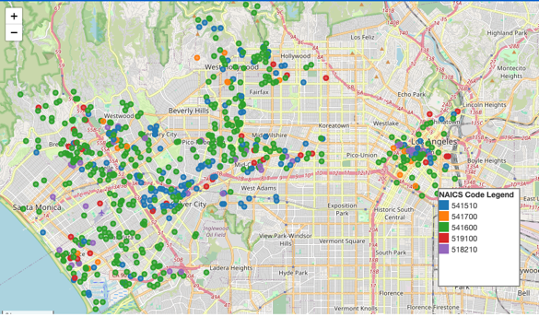
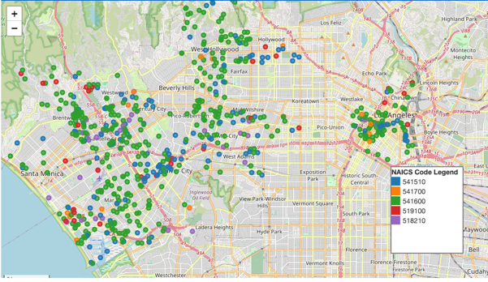
Tech Cluster Growth by Year
PREDICTED TECH COMPANY
GEO-DISTRIBUTION OVER TIME
2025
2026
2027
2028
2029

Slide 16
Project Challenges
Education data was difficult to download from SQL database as navigation is confusing and download time long.
Business data is massive. Many features are included and information is very robust, including location data and business descriptions. Filtering was extensive but fruitful.
Working with data was straight-forward, but processing long and crashed many times. While the original aim was to include all of L.A. County, it became essential to focus on specific Zip Codes where main activity occurs. Data processing proceeded much quicker.
Outlier years 2020 and 2021 (COVID) in both education and business data are anomalous and affected predictions, however the decline is real and may have long-lasting effects.

Slide 17

Key Findings
Educational attainment has a strong influence on tech startup clustering
Santa Monica, Venice, and Downtown Los Angeles have high correlation between the percentage of bachelor's degree holders and the number of tech startups.
Tech startup growth will continue in these areas over the next five years, but slower because of COVID.

Slide 18

Recommendations
Increase investment in educational infrastructure in areas like Santa Monica and Venice to further foster the growth of tech startups.
Develop targeted urban development policies that align educational opportunities with business incentives, particularly in areas with high potential for tech growth.
Monitor changes in tech startup clustering over time to adjust policies dynamically, ensuring continued support for the tech sector in key areas.

